Slide 1
Problem Statement:
A Drone is being used to deliver medicines in a hilly region with flight distance of 10 kms to destination. Unfortunately, the Drone is prone to attack by birds of prey such as Eagle, Crow etc. at around 5 kms from origin.
Design a system for Drone to deter the bird attacks and to safely traverse the remaining distance to destination to deliver the medicines. Cost of the system should not exceed Rs. 50000/- and weight of the proposed deterrence system should not exceed 1.5 kg.
Note: The hilly area is prone to drizzles and wind gust.
© 2025 Collins Aerospace. | Collins Aerospace Proprietary. | This document does not include any export controlled technical data.

Slide 2
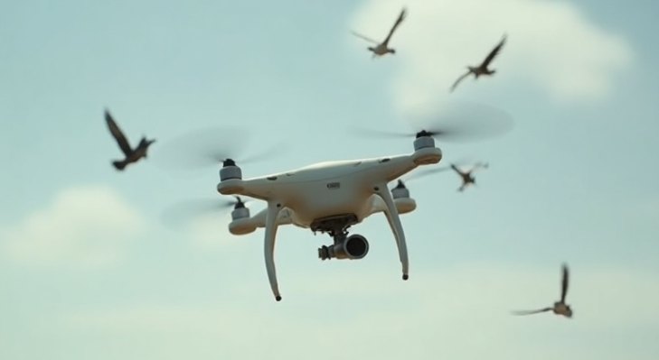
Bird-Deterrent Medical Drone for Hilly Regions
Problem Statement
Mid-flight bird attacks pose a threat to UAVs during medical deliveries in hilly terrains.
Birds, especially territorial ones, cause mission failures, risking both the package and drone.
There’s a lack of lightweight, integrated deterrence solutions on existing medical drones.
© 2025 Collins Aerospace. | Collins Aerospace Proprietary. | This document does not include any export controlled technical data.

Slide 3
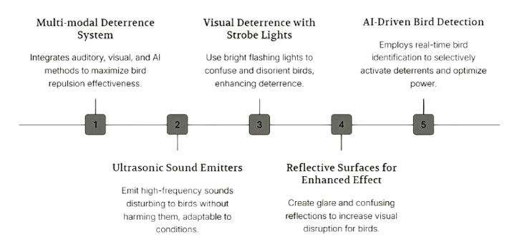
Proposed Solution
© 2025 Collins Aerospace. | Collins Aerospace Proprietary. | This document does not include any export controlled technical data.

Slide 4
How Our Design Stands Out
Feature | Existing Medical Drones | Our Enhanced Design
Bird Detection & Deterrence | ❌ Absent | ✅ Present
Adapted for Hilly Terrain | ⚠️ Partially | ✅ Weatherproof
Lightweight | ✅ Yes | ✅ Within 1.5kg
Affordable | ⚠️ Costly Add-ons | ✅ Under ₹50,000
GitHub Link:https://github.com/rebbasivesh/Bird-Deterrent-Medical-Delivery-Drone-for-Hilly-Terrains/blob/main/README.md
© 2025 Collins Aerospace. | Collins Aerospace Proprietary. | This document does not include any export controlled technical data.

Slide 5
Thank You
REBBA SIVESH
ECE, KL UNIVERSITY
siveshsarma255@gmail.com
© 2025 Collins Aerospace. | Collins Aerospace Proprietary. | This document does not include any export controlled technical data.

